Slide 1

Rusterizer Masterclass -
Powering up your Rusterizer
Pixels go brrrrrrr 🚀- Manon Oomen - manon@traverseresearch.nl

Slide 2
Who is this person?
Manon Oomen, BUAS/NHTV/IGAD alumni
Rendering Engineer at Traverse Research
Software rasterizing and low level performance enthusiast.

Slide 3
Agenda
Fix the basics
Profiling
Multi-threaded rasterization
SIMD Rasterization
Bag of Tricks

Slide 4




Before we tune anything
Make sure you measure all your changes.
Test with various scenes.
Profilers can help finding bottlenecks.
uProf, vTune, and VS are freely available.
SuperLuminal is awesome, but costs money
Add this to your Cargo.toml for symbols in release mode.
[profile.release]
debug = true

Slide 5

Fixing the basics first
✔️ Running with `--release`
✔️ Skip work where possible
Back face culling, Frustum culling
Early depth testing
✔️ Use flat simple data
✔️ Don’t call functions in your pixel fill loop.
✔️ Reduce unpredictable branches in hot code.
✔️ Not allocating memory in hot code
✔️ No performance ‘stupids’

Slide 6
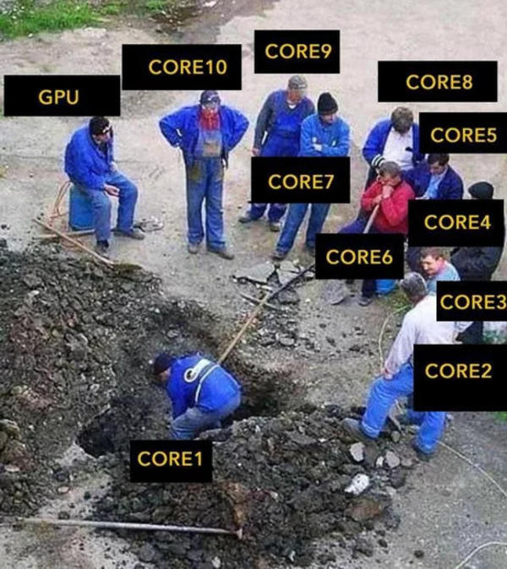
Multi-threaded rasterization
How to parallelize?
How to share data?
How to load balance?
How to keep cores fed?
I paid for the whole CPU, so I am gonna use the whole CPU!

Slide 7
How to parallelize?
Let one thread rasterize the triangle and generate fragments, let other cores do shading.
Model after GPU dedicated hardware block. Not efficient on the CPU. Mainly bandwidth constrained.
Lock screen region that core wants to access.
Cores will fight over locks and stall.
Bin triangles into tiles, process triangles per tile. Divide tiles over cores.
Basically what’s done on mobile GPUs, optimized for low bandwidth.

Slide 8
Tile Based Deferred Rendering
Not to be confused with ‘Tile Based Deferred Rendering’.
Process triangles in parallel, and bin them into a grid. (Coarse rasterization)
Then sync all the cores and rasterize triangles per tile.
No overlap on framebuffer.
⚠️🚨WARNING: Much unsafe code needed to do this properly.🚨⚠️

Slide 9
Tangent: mut is a misnomer
`mut` actually means `unique`
Multiple threads can’t share the same `mut` reference.
Usually, Mutex is used to synchronize.Not suitable if we are after performance.
Use `std::cell::UnsafeCell` to create safe wrappers.
⚠️🚨WARNING: Much unsafe code needed to do this properly.🚨⚠️

Slide 10
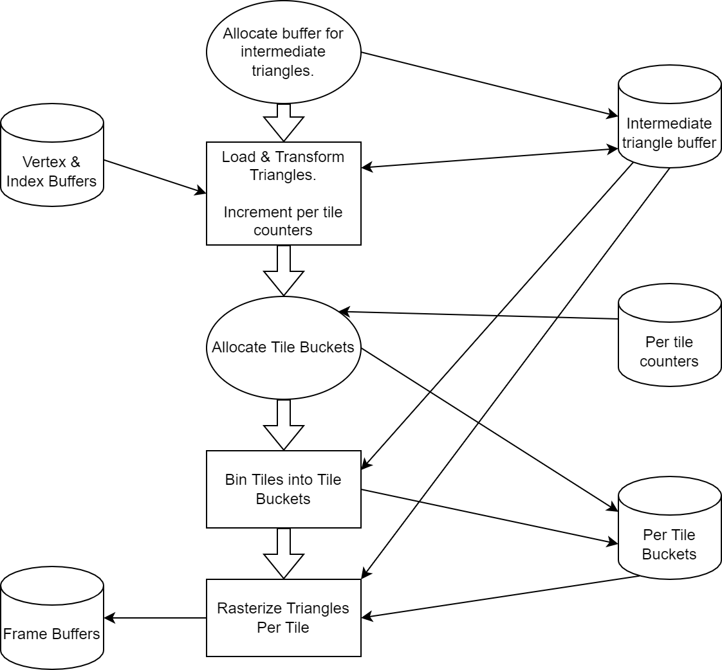

Tile Based Deferred Rendering
⚠️🚨WARNING: Much unsafe code needed to do this properly.🚨⚠️

Slide 11
Tile Based Deferred Rendering
How to let threads work through this data?
Put jobs in a queue and let worker threads grab jobs from that queue to execute -> Voila job system.
Small jobs will automatically load balance the job system, keeping cores as busy as possible.
Look into `std::sync::mpsc` for your job queue.
https://doc.rust-lang.org/book/ch16-02-message-passing.html

Slide 12
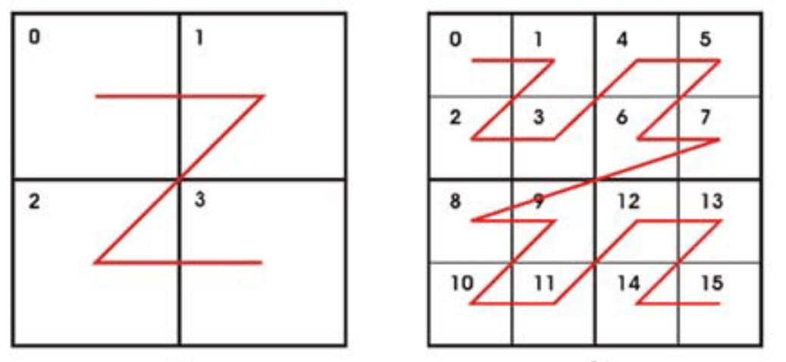
SIMD Rasterization
Use SSE or AVX (or even AVX-512) to process more pixels at a time.
Reorder framebuffer into 2x2 pixel quads.
Pixels must be aligned to 16 or 32 bytes.
Don’t use scanline technique. Loop over rectangle containing triangle instead.
Pixel quads are also what you use to implement mipmapping!
Don’t forget to unswizzle before presenting ;)

Slide 13

SIMD Rasterization in Rust
Enable nightly, and set target architecture
Enable nightly features (add to main.rs)
RUSTFLAGS='-C target-cpu=native' cargo +nightly build --release
#![feature(stdarch)]
#![feature(stdsimd)]
#[cfg(target_arch = "x86_64")]
unsafe {
use std::arch::x86_64::*;
// SIMD code goes here
let a = _mm_set_ps(0.0, 1.0, 2.0, 3.0);
let b = _mm_set_ps(4.0, 5.0, 6.0, 7.0);
let c = _mm_add_ps(a, b); }

Slide 14
SIMD Rasterization
Skip whole pixel block where possible.
Use masking to only write pixels that should be rendered.
Shuffling data can cost more than doing SIMD ops will give you in return. Always measure!

Slide 15
Bag of Tricks
Integer math hack to reduce number of compares in pixel fill loop.
Or bits together, if top bit is set, at least one value was negative.
let w_all = w0 | w1 | w2;
if w_all >= 0 {
// ...
}
if w0 >= 0 && w1 >= 0 && w2 >= 0 {
// ...
}

Slide 16
Bag of Tricks
Reduce plane checks in clipping
// Create mask for 6 clipping planes whether vertex is inside or outside.
fn gen_clip_mask(vertex: &AlignedFloat4) -> u32 {
const BITSPREAD_LUT: [u32; 16] = [
0b00000000, 0b00000001, 0b00000100, 0b00000101, 0b00010000, 0b00010001, 0b00010100,
0b00010101, 0b00000000, 0b00000001, 0b00000100, 0b00000101, 0b00010000, 0b00010001,
0b00010100, 0b00010101,
];
#[cfg(target_arch = "x86_64")]
unsafe {
use std::arch::x86_64::*;
// load vertex into xmm register
let v = _mm_load_ps(vertex.0.as_ptr());
// move the w component into all 4 slots
const MASK: i32 = _MM_SHUFFLE(3, 3, 3, 3);
let w = _mm_shuffle_ps::<MASK>(v, v);
let a = _mm_sub_ps(w, v); // a = w - v
let b = _mm_add_ps(w, v); // b = w + v
let maska = _mm_cmplt_ps(a, _mm_setzero_ps()); // a < 0
let maskb = _mm_cmplt_ps(b, _mm_setzero_ps()); // b < 0
let maska = BITSPREAD_LUT.get_unchecked(_mm_movemask_ps(maska) as usize);
let maskb = BITSPREAD_LUT.get_unchecked(_mm_movemask_ps(maskb) as usize) << 1;
maska | maskb
}
#[cfg(not(target_arch = "x86_64"))]
{
let w = vertex[3];
let a = [w - vertex[0], w - vertex[1], w - vertex[2]];
let b = [w + vertex[0], w + vertex[1], w + vertex[2]];
let maska =
((a[0] < 0.0) as u32) | (((a[1] < 0.0) as u32) << 1) | (((a[2] < 0.0) as u32) << 2);
let maskb =
((b[0] < 0.0) as u32) | (((b[1] < 0.0) as u32) << 1) | (((b[2] < 0.0) as u32) << 2);
let maska = unsafe { BITSPREAD_LUT.get_unchecked(maska as usize) };
let maskb = unsafe { BITSPREAD_LUT.get_unchecked(maskb as usize) } << 1;
maska | maskb
}
}
let clip_masks = [
gen_clip_mask(&v0),
gen_clip_mask(&v1),
gen_clip_mask(&v2),
];
// Discard triangle if all vertices are outside of the same clipping plane.
if (clip_masks[0] & clip_masks[1] & clip_masks[2]) != 0 {
continue;
}
let clip_mask_any = clip_masks[0] | clip_masks[1] | clip_masks[2];
// ...
// Sutherland-Hodgman clipping
for plane_index in 0..6 {
if (clip_mask_any & (1 << plane_index)) == 0 {
continue;
}
// Rest of the clipping algo
}
⬆️ Above function can also be used for frustum culling 🚀

Slide 17
Bag of Tricks
Use `MaybeUninit` to remove initialization overhead.
#![feature(maybe_uninit_extra)]
#![feature(new_uninit)]
#![feature(maybe_uninit_slice)]
#![feature(maybe_uninit_uninit_array)]
#![feature(maybe_uninit_write_slice)]
#![feature(maybe_uninit_array_assume_init)]
let mut vertex_redirection_table: [MaybeUninit<u32>; INDICES_PER_BATCH] =
MaybeUninit::uninit_array();
let mut deduplicated_indices: [MaybeUninit<u32>; INDICES_PER_BATCH] =
MaybeUninit::uninit_array();
let deduplicated_vertex_count = deduplicate_vertices(
&index_buffer[start_index_location..start_index_location + index_count],
&mut vertex_redirection_table,
&mut deduplicated_indices,
);
let deduplicated_indices = unsafe {
MaybeUninit::slice_assume_init_ref(&deduplicated_indices[..deduplicated_vertex_count])
};
let vertex_redirection_table =
unsafe { MaybeUninit::slice_assume_init_ref(&vertex_redirection_table[..index_count]) };

Slide 18
More to do and learn
Implement mip mapping + texture block compression.
Swizzle textures for better cache coherency.
Depth sort triangles after tiling.
Don’t be afraid to dive into the assembly.
You are never done finding more optimizations ^.^
Software Rasterizer on the GPU?

Slide 19
Thank you!
Any more questions?
Happy coding!

